Slide 1
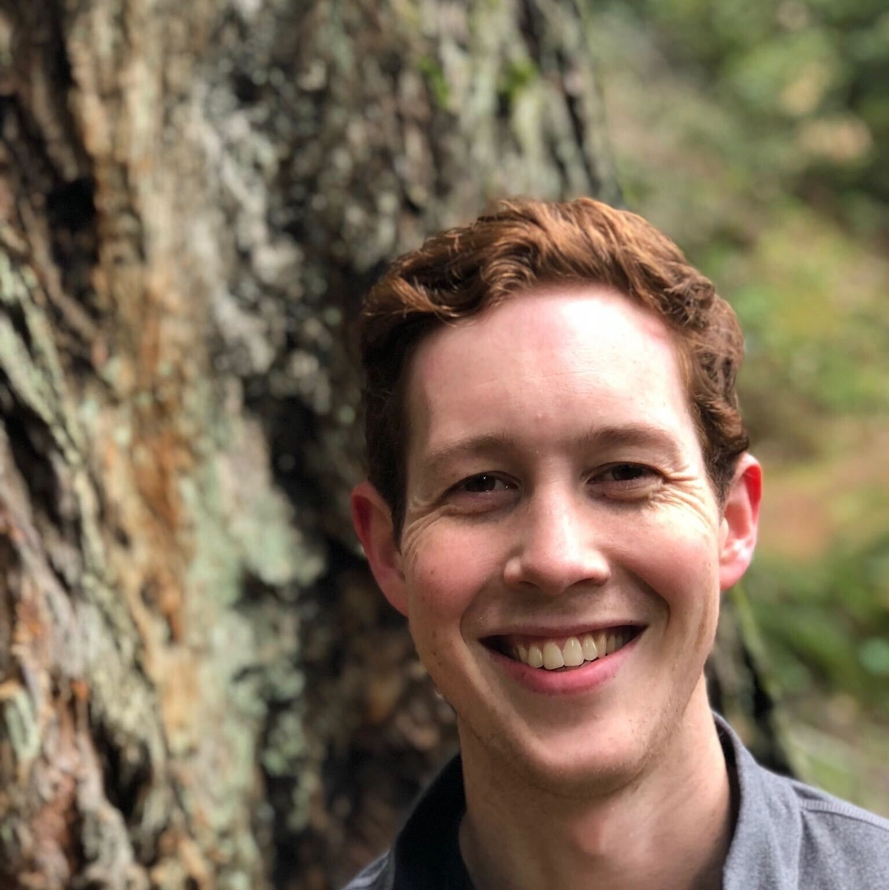
Allen Foss Manager — Cloud & Product
Email
allen.foss@thebridge.com
Location
McKinney, Texas
Allen joined The Bridge in Febuary 2019 and has over 11 years of Technology Strategy and Digital Transformation project leadership expereince. From Fortune 100 to small Non-Profits, Allen has lead teams and helped clients take their visions and turn them into reality.
EXPERIENCE
Industry Experience
Distribution | Logistics & Transportation | Non-Profit | Consumer Package Goods
Digital Transformation | Distribution
Oversaw the complete design and development of a custom .net desktop application and mobile based application for warehouse discrepancy reporting, leading to a $3+ million operational opportunity and $2.7 million bottom-line savings in fiscal year 2021.
Led Integrated efforts with WMS, AR/AP, and Transportation PCS software for streamlined usability between teams and warehouse components.
Directed a development team in creating custom Android mobile and desktop applications catering to 700+ truck drivers and operational team members. These applications facilitate credit pickup and backhaul capabilities and integrated with PCS, iSeries, APIs, and EDI for seamless operations.
Led development team and business users through AWS cloud data transformation project for 160k+ items, creating new master data model, product maintenance application, and supplier onboarding application for 1500 suppliers and 400 business end users.
Managed and executed the migration of legacy iSeries system pricing functionality into the Pricefx system, facilitating streamlined future pricing operations and capabilities.
Technology Strategy | Non-Profit
Led digital tranformation and strategy developing websites and admin work assistance to help CEO in day-to-day operations and enter new platforms.
Strategy Lead for Business Council for the Arts Dallas, researching and analyzing current market position - developed marketing plan, comprehensive roadmap, and new membership model.
BACKGROUND
Functional Skills
Project Leadership, Digital Transformation
Qualifications
Professional Scrum Master Certification - PSM1

Slide 2

Email
allen.foss@thebridge.com
Location
McKinney, Texas
Allen joined The Bridge in Febuary 2019 and has over 11 years of Technology Strategy and Digital Transformation project leadership expereince. From Fortune 100 to small Non-Profits, Allen has lead teams and helped clients take their visions and turn them into reality.
Allen Foss Manager
Cloud and Product

Slide 3
Allen Foss Manager – Cloud & Product
Email
allen.foss@thebridge.com
Location
McKinney, Texas
BACKGROUND
EXPERIENCE
Functional Skills
Project Leadership, Data Analytics, Data Strategy, Digital Transformation
Qualifications
Professional Scrum Master Certification - PSM1
Industry Experience
Distribution | Logistics & Transportation | Non-Profit | Consumer Package Goods
Digital Transformation | Distribution
Oversaw the complete design and development of a custom .net desktop application and mobile based application for warehouse discrepancy reporting, leading to a $3+ million operational opportunity and $2.7 million bottom-line savings in fiscal year 2021.
Led Integrated efforts with WMS, AR/AP, and Transportation PCS software for streamlined usability between teams and warehouse components.
Directed a development team in creating custom Android mobile and desktop applications catering to 700+ truck drivers and operational team members. These applications facilitate credit pickup and backhaul capabilities and integrated with PCS, iSeries, APIs, and EDI for seamless operations.
Led development team and business users through AWS cloud data transformation project for 160k+ items, creating new master data model, product maintenance application, and supplier onboarding application for 1500 suppliers and 400 business end users.
Managed and executed the migration of legacy iSeries system pricing functionality into the Pricefx system, facilitating streamlined future pricing operations and capabilities.
Technology Strategy | Non-Profit
Led digital tranformation and strategy developing websites and admin work assistance to help CEO in day-to-day operations and enter new platforms.
Strategy Lead for Business Council for the Arts Dallas, researching and analyzing current market position - developed marketing plan, comprehensive roadmap, and new membership model.

